Slide 1
Introduction to Presentation
Project Recap
Mock Course Manager System
Requirements & Design
Implementation & Testing
Progress made for Iteration 1
Challenges
Planned Action Steps
Conclusion
Notes:
My name is Spencer Yoder
Skyward Federal Team
Our work since the previous OPR has largely related to getting our infrastructure in place for our system

Slide 2
Project Recap
Skyward Federal - Cyber-Logistics startup
Create secure custom applications for government clients
Data is usually separated physically by security level
Inefficient and multiple points of failure
Problem: how to create a centralized, virtualized, multi-level security data store?
Last time, we talked about…
Research
Project scope
System design - two main components:
Container Runtime
Data Storage
What we were missing from Skyward Federal
Notes:
First bullet is pretty much verbatim
Current problem MLS API (COPS) addresses this.
Inefficient in terms of overhead and complicated development
Talk about the scope of this project -- all our requirements are abstract and more related to design than functionality
Talk about CR and DS on next slide
We were missing some virtual machines with SELinux installed and got them last week

Slide 3
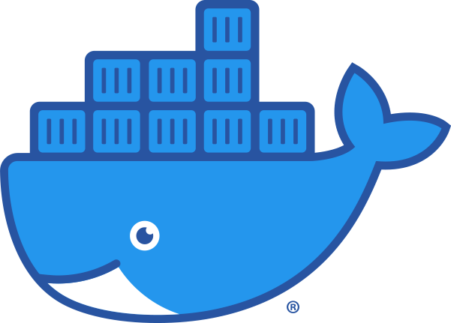
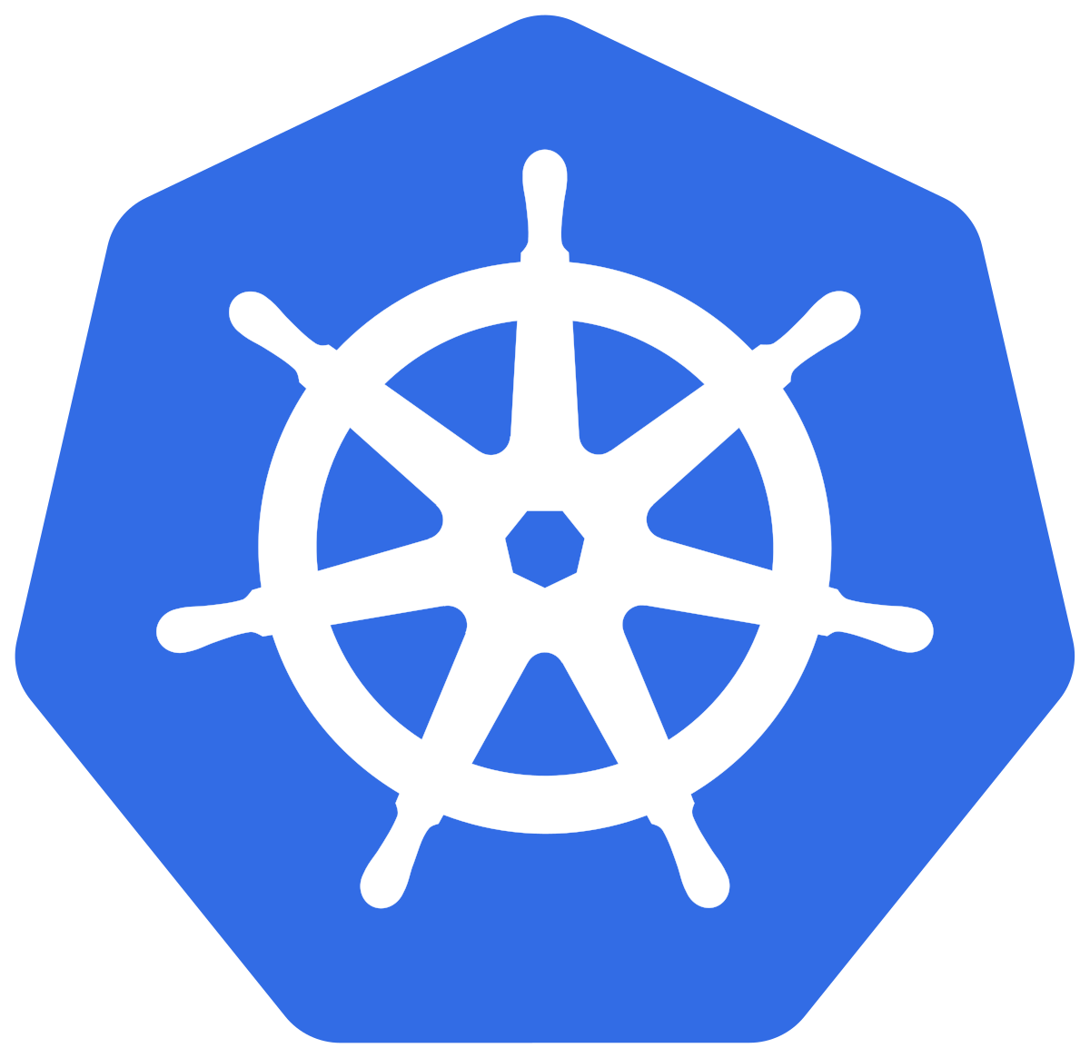

Project Recap - Overall Requirements
Container Runtime Component
Creates container to run isolated RESTful Service with the authorization levels of the user
Container can be activated/deactivated at arbitrary times
Multiple containers can run services simultaneously
Data Storage Component
Data stored in database with Security Enhanced (SE) Linux labels
User restricted to accessing data based on their own security context
Users can write/edit data after labeling
Notes:
Our overall requirements have not changed
Container runtime is responsible for the virtualization of the system
Data storage is responsible for maintaining security at the OS level
Both are required for the system to be centralized

Slide 4
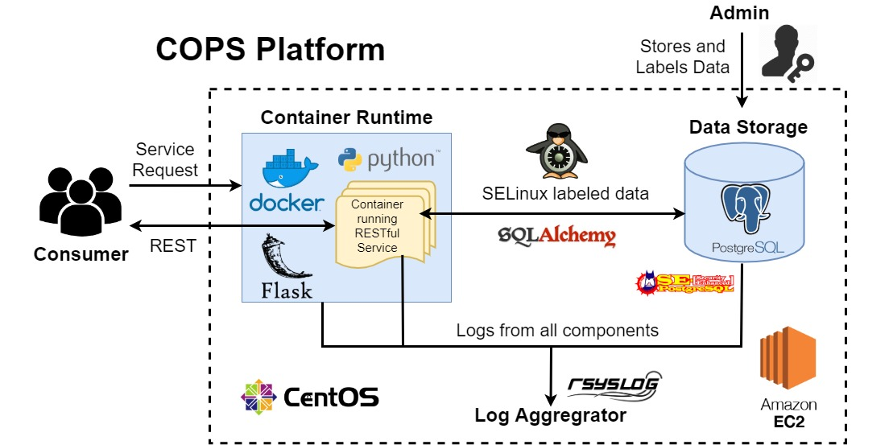

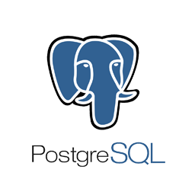
Recap - Our System at High Level
Focus for Today:
RESTful Service that communicates with our Database (Data Storage) and the User
Container Runtime
User
Service Request
Data Storage
Container running RESTful
Service
REST request
Process request
Return authorized data
REST response
Notes:
This is our design
Notice how RESTful service is arbitrary. We solved this problem in the time since OPR 1

Slide 5
Progress - Iteration 1 Requirements
We received lots of detailed requirements from our sponsor…
But they were for an abstract system
CourseManager RESTful Service
Concrete
Simple
Lets us test our underlying infrastructure
3 Users
Coordinators
Instructors
Students
Spencer Yoder
Notes:
One of our accomplishments from iteration 0 was specifying a concrete system which fulfills the requirements of one of these abstract systems
The goal for course manager was to create the system which was quick and easy to implement while able to fully test security - our true deliverable
These are our users, we’ll talk a bit more about them next slide

Slide 6
Progress - Use Cases for Course Manager
UC1 - Logging In (All Users)
UC2 - Viewing Account Details (All Users)
UC3 - Course Modification (Coordinators)
UC4 - User Modification (Coordinators)
UC5 - Grade Modification (Instructors)
UC6 - Viewing Course Schedule (Instructors & Students)
Spencer Yoder
Notes:
Describe how the system interacts

Slide 7
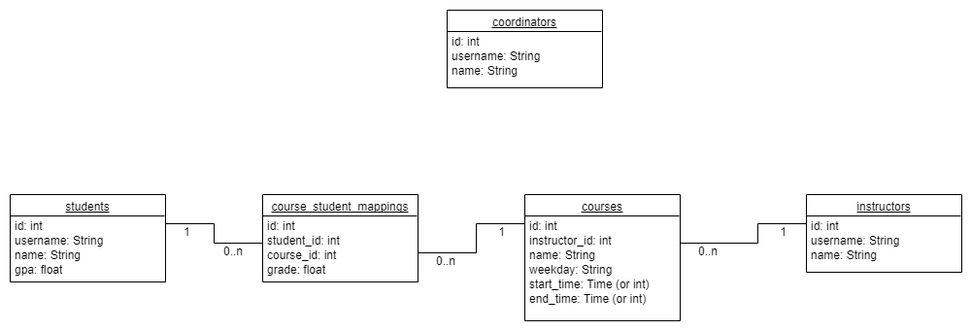
Progress - Design: Database Schema
Spencer Yoder
Notes:
This is our database schema. Since our project is very database-oriented, the rest of the details about CourseManager grew from here.

Slide 8
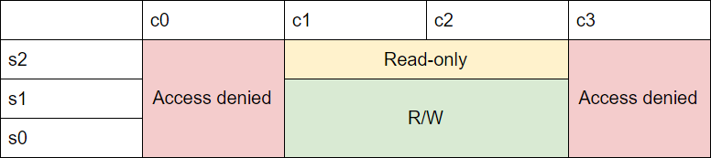
Progress - Design: Security Policy
Security context:
s1:c1.c2
Cannot access any data outside your designated category
Can read any data within your category
Can only write data within your category and security level
Spencer Yoder
Notes:
SELinux enforces security based on unique security contexts for each file/data item.
Security contexts are made of categories and security levels.
But how security is enforced is determined by the admin (security policy).
This is a simple policy which is perfect for our system.

Slide 9
Progress - Design: Database Security
 | c0 (visible to instructors) | c1 (visible to instructors and students) | c2 (visible to students) | c3 (visible to coordinators only)
s2 (writeable by coordinators only) | instructors | courses, course_student_mappings, students.name, instructors.name | students | coordinators
s1 (writeable by coordinators and instructors) |  | course_student_mappings.grade
s0 (writeable by students)
Security Labels
Coordinator
s2:c0.c3
Instructor
s1:c0.c1
Student
s0:c1.c2
Spencer Yoder
Notes:
This table shows how we’ll put the policy from the previous slide into practice
Make sure to cover
Different columns can have different contexts
Security between relationships is important

Slide 10
Progress - Design: UML Class Diagram
App
models
users
controllers
CourseController
Course
0..n 1
Instructor
Coordinator
UserController
0..n 1
CourseStudentMapping
0..n 1
Student
LoggingUtil
Jonathan Balliet
Notes:
This is how our system looks on the backend
These represent python classes which correspond to tables in the database
This is simplified, there’s a bit more nuance in the Python classes. Also our original UML has changed.

Slide 11



Progress - Resource Decisions
Decided on programming language
Python!
Good for automation and creating a prototype
Suggested by Skyward
Flask Framework
Web application backend using Python
Simple implementation of REST API
SQLAlchemy
Object-relational mapping (ORM)
Used to create Models for each table in our database
Everyone
Notes:
Python
We don’t wanna do Java
Has lots of good libraries which can talk to Postgres
Flask
Allows us to do the API
SQLAlchemy
Analogous to Hibernate

Slide 12
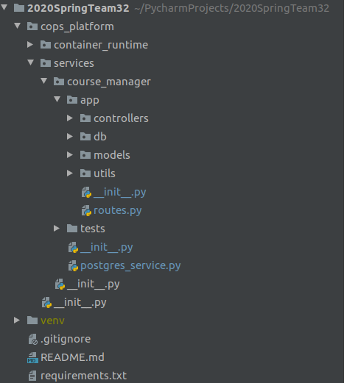
Progress - Iteration 1 Implementation
Python and Pycharm set up on everyone’s computers
Project structure set up
SEPostgres installed on AWS development machines!
Began coding model classes using SQLAlchemy
Began coding app and controller classes with Flask
Everyone
Notes:
It was a horrible experience installing SEPostgres

Slide 13
Progress - Iteration 1 Testing
For students...
 | Whole tables | Single columns | Relationships
I should be able to access... | Equivalence class | Equivalence class | Equivalence class
I shouldn’t be able to access... | Equivalence class | Equivalence class | Equivalence class
Everyone
Notes:
Our primary testing focus for iteration 1 is our security

Slide 14
Team Contribution Breakdown
Data Storage Team (Database, SEPostgres config)
Daniel Mills
Spencer Yoder
Container Runtime Team (Everything else)
Jonathan Balliet
Jeen Shaji
Caleb Boswell
Notes:
These teams are just for iteration 1

Slide 15
Challenges
Navigating abstract system specifications
Lack of development environment
Difference between project pace and class pace
Heavy dependence on sponsor knowledge
Lots of technical configuration
Unknown time frame
Outdated and contradictory instructions for SEPostgres
Notes:
Vent for as much time as you have

Slide 16
Action Steps
Finish iteration 1
Set up SEPostgres on Skyward’s computers
Integrate security labels with database columns and tables
Implement one API for CourseManager
Construct Models
Unit Tests
Start iteration 2
Implement remaining API’s for CourseManager
Remaining Unit Tests
System Tests
Notes:
Iteration 1 is about infrastructure
Iteration 2 is about CourseManager
Subsequent iterations are about fleshing out the COPS system

Slide 17
Conclusion
We created a concrete system to fulfill sponsor requirements
We received and began configuring a set of virtual machines
For iteration 1, we plan to be able to support a single REST API call
Subsequent iterations involve
Completely implementing CourseManager
Dockerizing CourseManager Service - support single user connection
Achieve stretch goals agreed upon by our sponsor

